Slide 1
Microwave Sensor with Arduino for humans and objects detection behind walls
THIRD
REVIEW GUIDE : Prof. BHARATH REDDY GUDIBANDI
Group MEMBERS: 1.Dhruva Rakesh B – 19BES7003 2.Dulam Sai Varun Goud – 19BES7031 3.Venishetti Nithin – 19BES7038

Slide 2
Agenda
Novelty
Application
Digital Microwave Sensor
Arduino Nano
Display OLED 128x64
Tools Used
Circuit Diagram
Pin configuration
Arduino Program
Implementation
Results
References

Slide 3
NOVELTY
In the real time scenario there are many projects based on Microwave sensor.
Our project is different from the previously existed projects.
A microwave sensor broadcasts a variety of microwaves at various frequencies toward a detection area, and then performs an object detection operation using the microwave waves that are reflected off an object that is present in the detection region.
We have used this digital Microwave Sensor with Arduino for moving humans and objects detection behind the walls. This digital microwave Sensor uses doppler radar to detect moving objects using microwaves.
The microwaves are sensitive to a variety of objects and the amazing thing is its sensor readings are not affected by ambient temperatures. So, that’s why, this type of sensor is widely used in industrial, transportation, and civil applications.

Slide 4
Application
This type of microwave sensor is widely used in industrial, transportation, and civil applications such as measuring vehicle speed, liquid levels, automatic door motion detection, automatic washing, production line material detection and car reversing sensors, etc.
The microwave sensor can be useful together with other sensors to enhance its measurement accuracy. For example, Microwave sensor could decrease the pseudo fault report rate of human motion detection. And it does a good job in safety & security work.

Slide 5
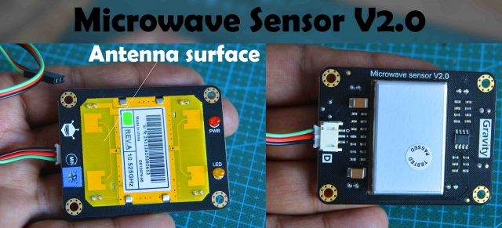
Digital Microwave Sensor:
The microwave sensor applies the Doppler effect to detect moving objects using microwaves. This differs from the method used by a regular infrared (IR) sensor as microwave is sensitive to a variety of objects that are microwave-reflective, and its sensor readings are not affected by the ambient temperature.
The microwave detection method has the following advantages compared to other methods:
Non-contact detection
Readings not affected by temperature, humidity, noise, air, dust or light - suitable for harsh environments
Strong resistance to radio frequency interference
Low output, unharmful to human
Wide detection range and high velocity
Supports non-living object detection

Slide 6
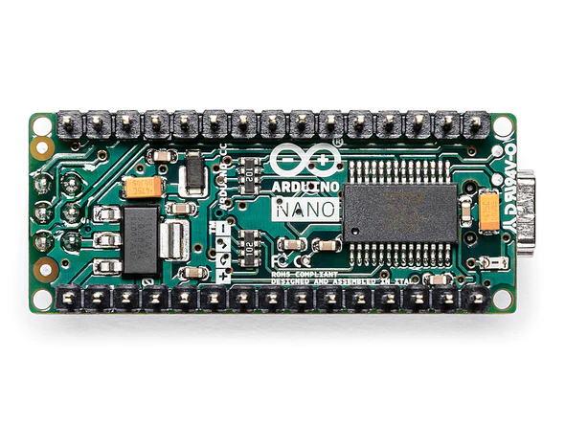
Arduino Nano
The Arduino Nano is a small, complete, and breadboard-friendly board based on the ATmega328 (Arduino Nano 3.x). The Arduino Nano is Arduino's classic breadboard friendly designed board with the smallest dimensions. The Arduino Nano comes with pin headers that allow for an easy attachment onto a breadboard and features a Mini-B USB connector.
The ATMega328 CPU runs with 16 MHz and features 32 KB of Flash Memory (of which 2 KB used by bootloader).

Slide 7
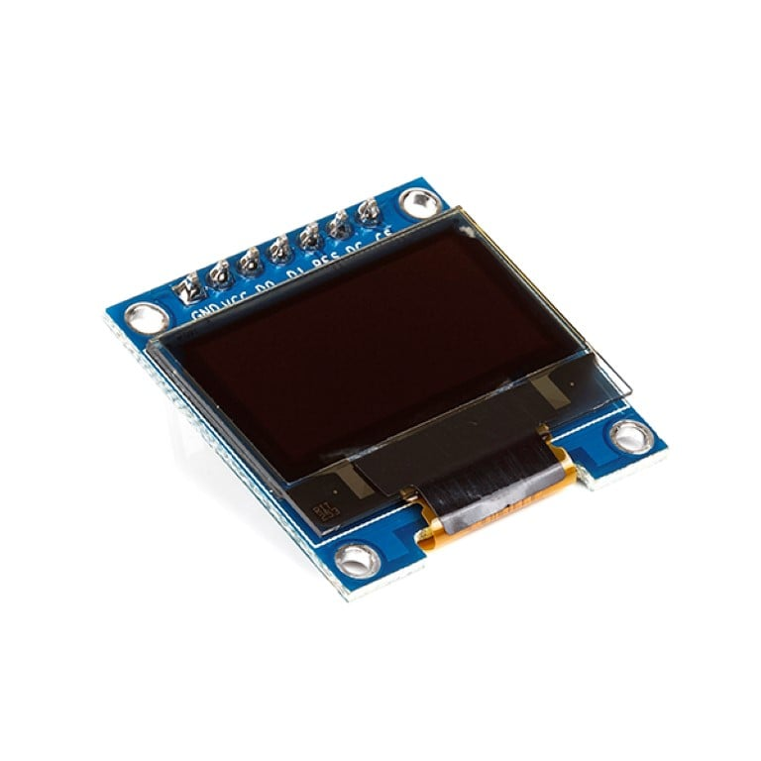
Display OLED 128x64
This 0.96″ OLED Display Module offers 128×64 pixel resolution. They are featuring much less thickness than LCD displays with good brightness and also produce better and true colours.
This OLED Display Module is very compact and will add a great ever user interface experience to your Arduino project. The connection of this display with Arduino is made through the I2C(also called as IIC) serial or SPI interface.
The 0.96″ OLED Display Module produces blue text on black background with very good contrast when supplied with DC 2.8V supply. The OLED Display Modules also offers a very wide viewing angle of about greater than 160°.

Slide 8
Tools Used:
Digital Microwave Sensor V2.0
Jumper Wires
Bread board
Arduino Nano 3.0 M1
Display OLED 128x64
470 uf Capacitor
7805T Voltage Regulator
33DCJ-0202-A DC POWER JACK

Slide 9
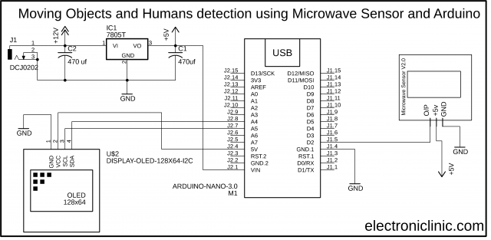
Circuit Diagram:

Slide 10
Pin Configuration:
The output pin of the microwave sensor is connected with the digital pin D2 of the Arduino while the +5v and GND pins are connected with the Arduino’s 5v and GND pins.
On the top left side is the regulated 5V power supply based on the LM7805 voltage regulator. J1 is the DC female power jack and this is where we connect a 12v adaptor, battery, or a solar panel.
The SCL and SDA pins of the Oled display module are connected with the A5 and A4 pins of the Arduino.

Slide 11
Microwave Sensor Arduino Programming:
#include <SPI.h>
#include <MsTimer2.h> //Timer interrupt function library
#include <Adafruit_GFX.h>
#include <Adafruit_SSD1306.h>
#define SCREEN_WIDTH 128 // OLED display width, in pixels
#define SCREEN_HEIGHT 64 // OLED display height, in pixels
// Declaration for an SSD1306 display connected to I2C (SDA, SCL pins)
#define OLED_RESET -1 // Reset pin # (or -1 if sharing Arduino reset pin)
#define SCREEN_ADDRESS 0x3D
Adafruit_SSD1306 display(SCREEN_WIDTH, SCREEN_HEIGHT, &Wire, OLED_RESET);

Slide 12
int pbIn = 0; // Define interrupt 0 that is digital pin 2 int ledOut = 13; // Define the indicator LED pin digital pin 13 int number=0; // Interrupt times volatile int state = LOW; // Defines the indicator LED state, the default is not bright void setup() { Serial.begin(9600); pinMode(ledOut, OUTPUT); attachInterrupt(pbIn, stateChange, FALLING); // Set the interrupt function, interrupt pin is digital pin D2, // interrupt service function is stateChange (), when the D2 // power change from high to low , the trigger interrupt. MsTimer2::set(3000, Handle); //Set the timer interrupt function, running once Handle() function per 1000ms MsTimer2::start(); //Start timer interrupt function display.begin(SSD1306_SWITCHCAPVCC, 0x3C); display.clearDisplay(); display.display(); }

Slide 13
void loop() { display.setTextSize(2); display.setTextColor(WHITE); display.setCursor(0,5); display.println("status: "); display.setTextSize(3); display.setTextColor(WHITE); display.setCursor(0,30); display.println(number); display.display(); display.clearDisplay(); delay(10); } void stateChange(){ //Interrupt service function number++; //Interrupted once, the number + 1 } void Handle(){ //Timer service function number = 0; }

Slide 14
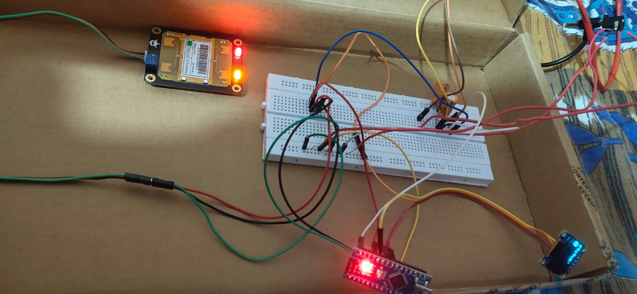
Implementation:

Slide 15
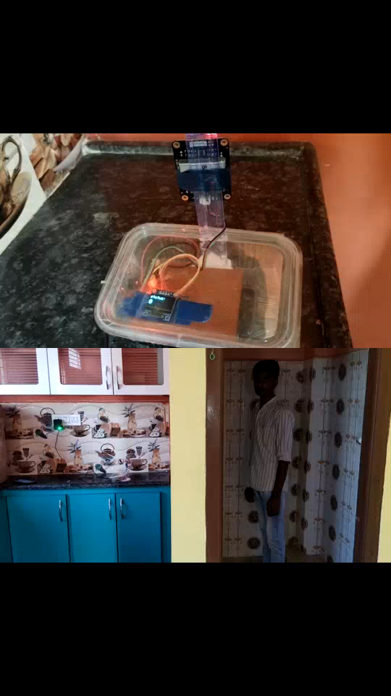
Results:
Test Case 1:
4 inches wall

Slide 16
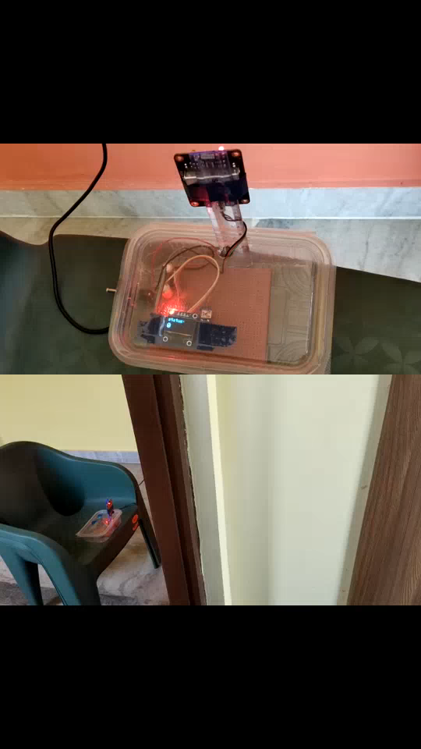
Results:
Test Case 2:
14 inches wall

Slide 17
REFERENCES
[1] A. Joseph, V. Parmar and V. Bagyaveereswaran, "Design of Human Detection Robot for Natural calamity Rescue Operation," 2019 Innovations in Power and Advanced Computing Technologies (i-PACT), 2019, pp. 1-5, doi: 10.1109/i-PACT44901.2019.8959959.
[2] Reshma Joju et al 2017 IOP Conf. Ser.: Mater. Sci. Eng. 263 052053
[3] Manchineella, Laxmi Samyuktha, Motion Detection Using Microwave Radar Sensor (July 8, 2021). Available at SSRN: https://ssrn.com/abstract=3918233 or http://dx.doi.org/10.2139/ssrn.3918233
[4] Kumar, M.J.A., Raj, M. and Sandhiya, S.R., 2021. IOT BASED HUMAN DETECTION ROBOT FOR RESCUE OPERATIONS. Design Engineering, pp.4250-4258.
[5] Bhadouria, V.S., Akhter, Z., Akhtar, M.J. and Munshi, P., 2021. Automated microwave monitoring of hidden objects for strategic and security applications. Journal of Electromagnetic Waves and Applications, 35(18), pp.2492-2509.

Slide 18
REFERENCE LINKS
https://www.electroniclinic.com/microwave-sensor-with-arduino-for-humans-and-objects-detection-behind-walls/
https://www.youtube.com/watch?v=CyZRINdPuks
https://www.dfrobot.com/product-1403.html
https://github.com/jxmot/ESP8266-RCWL0516
https://github.com/turingbirds/motionsensor

Slide 19

Time Plan Met
Project Proposal : AUGUST 20, 2022
PROJECT PLANNING : OCTOBER 14, 2022
ANALYSING THINGS : OCTOBER 20, 2022
FIRST REVIEW TO BE GIVEN : OCTOBER 22, 2022
MATERIAL TO BE PURCHASED : NOVEMBER 04, 2022
INITIALISING THE CONNECTIONS : NOVEMBER 08, 2022
ANALYSING THE CIRUIT : NOVEMBER 12, 2022
SECOND REVIEW TO BE GIVEN : NOVEMBER 26, 2022
INITIALISING THE CODING MODULE : NOVEMBER 23, 2022
FINALISING THE CONNECTIONS : NOVEMBER 25, 2022
FINALISING THE CODING MODULE : DECEMBER 12, 2022
FINAL DESIGN SPECIFICATION :DECEMBER 15, 2022
PROGRESS OF TESTING : DECEMBER 16, 2022
FINAL DEMO CHECK : DECEMBER 17,2022
FINAL REVIEW OF THE PROJECT : DECEMBER 27, 2022
SUBMISSION OF THE PROJECT : DECEMBER 29, 2022

Slide 20
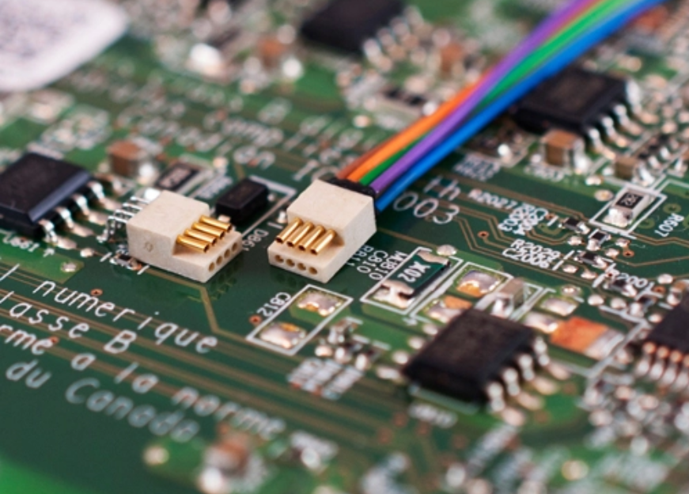
THANK YOU

